Slide 1

Chapter 8
Switching
8.<number>
Copyright © The McGraw-Hill Companies, Inc. Permission required for reproduction or display.

Slide 2

Figure 8.1 Switched network
8.<number>

Slide 3

Figure 8.2 Taxonomy of switched networks
8.<number>

Slide 4
8-1 CIRCUIT-SWITCHED NETWORKS
A circuit-switched network consists of a set of switches connected by physical links. A connection between two stations is a dedicated path made of one or more links. However, each connection uses only one dedicated channel on each link. Each link is normally divided into n channels by using FDM or TDM.
Topics discussed in this section:
Three Phases
Efficiency
Delay
Circuit-Switched Technology in Telephone Networks
8.<number>

Slide 5

Figure 8.3 A trivial circuit-switched network
8.<number>

Slide 6

Note
In circuit switching, the resources need to be reserved during the setup phase;
the resources remain dedicated for the entire duration of data transfer until the teardown phase.
8.<number>

Slide 7
Example 8.1
As a trivial example, let us use a circuit-switched network to connect eight telephones in a small area. Communication is through 4-kHz voice channels. We assume that each link uses FDM to connect a maximum of two voice channels. The bandwidth of each link is then 8 kHz. Figure 8.4 shows the situation. Telephone 1 is connected to telephone 7; 2 to 5; 3 to 8; and 4 to 6. Of course the situation may change when new connections are made. The switch controls the connections.
8.<number>

Slide 8

Figure 8.4 Circuit-switched network used in Example 8.1
8.<number>

Slide 9
Example 8.2
As another example, consider a circuit-switched network that connects computers in two remote offices of a private company. The offices are connected using a T-1 line leased from a communication service provider. There are two 4 × 8 (4 inputs and 8 outputs) switches in this network. For each switch, four output ports are folded into the input ports to allow communication between computers in the same office. Four other output ports allow communication between the two offices. Figure 8.5 shows the situation.
8.<number>

Slide 10

Figure 8.5 Circuit-switched network used in Example 8.2
8.<number>

Slide 11

Figure 8.6 Delay in a circuit-switched network
8.<number>

Slide 12
Note
Switching at the physical layer in the traditional telephone network uses
the circuit-switching approach.
8.<number>

Slide 13
Blocking or Non-blocking
Blocking
  A blocking network is unable to connect end- points because the critical paths are in use and there are no alternative paths
  Used on voice systems
    Short duration calls
Non-blocking
  Permits all stations to connect (in pairs) at once
  Used for some data connections
8.<number>

Slide 14
Circuit-Switched Routing
Many connections will need paths through more than one switch
Need to find a route
  Efficiency
  Resilience
Public telephone switches are a tree structure
  Static routing uses the same approach all the time
Dynamic routing allows for changes in routing depending on traffic
  Uses a peer structure for nodes
8.<number>

Slide 15
Alternate Routing
Possible routes between end offices predefined
Originating switch selects appropriate route
Routes listed in preference order
Different sets of routes may be used at different times
8.<number>

Slide 16
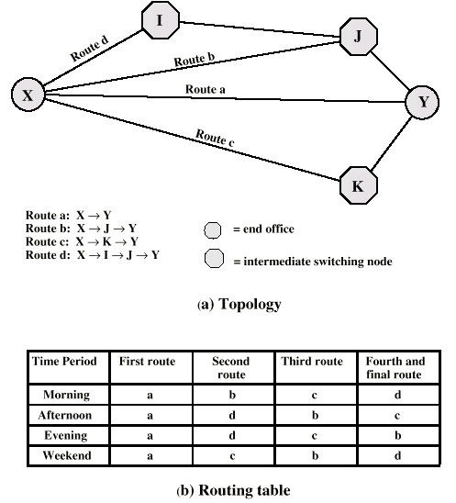
Alternate Routing Diagram
8.<number>

Slide 17
Control Signaling Functions
Audible communication with subscriber
Transmission of dialed number
Call can not be completed indication
Call ended indication
Signal to ring phone
Billing info
Equipment and trunk status info
Diagnostic info
Control of specialist equipment
8.<number>

Slide 18
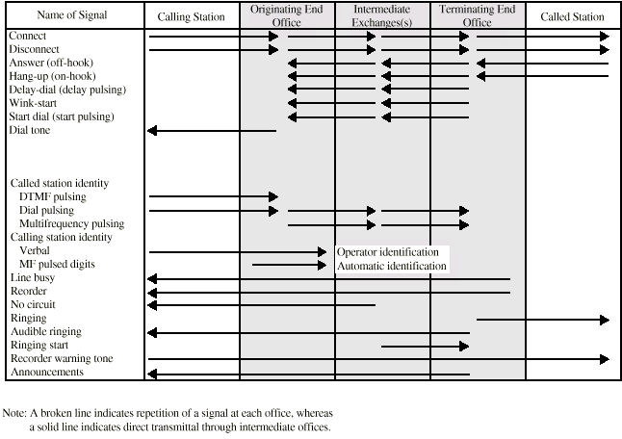
Control Signals
8.<number>

Slide 19
Location of Signaling
Subscriber to network
  Depends on subscriber device and switch
Within network
  Management of subscriber calls and network
  More complex
8.<number>

Slide 20
In-Channel Signaling
Use same channel for signaling and call
  Requires no additional transmission facilities
Inband
  Uses same frequencies as voice signal
  Can go anywhere a voice signal can
  Impossible to set up a call on a faulty speech path
Out-of-band
  Voice signals do not use full 4kHz bandwidth
  Narrow signal band within 4kHz used for control
  Can be sent whether or not voice signals are present
  Need extra electronics
  Slower signal rate (narrow bandwidth)
8.<number>

Slide 21
Drawbacks of In-Channel Signaling
Limited transfer rate
Delay between entering address (dialing) and connection
Overcome by use of common channel signaling
8.<number>

Slide 22
Common Channel Signaling
Control signals carried over paths independent of voice channel
One control signal channel can carry signals for a number of subscriber channels
Common control channel for these subscriber lines
Associated Mode
  Common channel closely tracks interswitch trunks
Disassociated Mode
  Additional nodes (signal transfer points)
  Effectively two separate networks
8.<number>

Slide 23
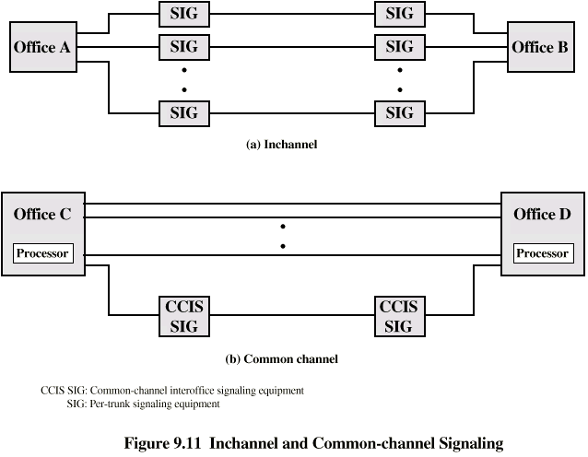
Common vs. In-Channel Signaling
8.<number>

Slide 24
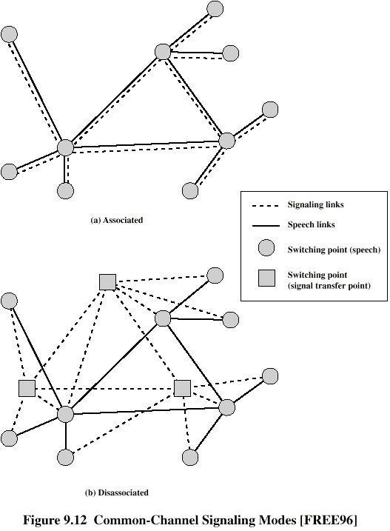
Signaling
Modes
8.<number>

Slide 25
Signaling System Number 7
SS7
Most widely used common channel signaling scheme
Internationally standardized and general purpose
8.<number>

Slide 26
SS7
SS7 network and protocol used for:
  Basic call setup, management, tear down
  Wireless services such as PCS, roaming, authentication
  Toll free and toll (900) wireline services
  Enhanced features such as call forwarding, caller ID, 3-way calling
  Efficient and secure worldwide telecommunications
8.<number>

Slide 27
8-2 DATAGRAM NETWORKS
In data communications, we need to send messages from one end system to another. If the message is going to pass through a packet-switched network, it needs to be divided into packets of fixed or variable size. The size of the packet is determined by the network and the governing protocol.
Topics discussed in this section:
Routing Table
Efficiency
Delay
Datagram Networks in the Internet
8.<number>

Slide 28
Two Basic Forms of Packet Switching
Packets handled in two ways
  Datagram (covered in this section)
  Virtual circuit (covered in the next section)
8.<number>

Slide 29
Datagram
Each packet treated independently
Packets can take any practical route
Packets may arrive out of order
Packets may get lost or delayed
Up to receiver to re-order packets and recover from missing packets
8.<number>

Slide 30
Virtual Circuit
Preplanned route established before any packets sent
Call request and call accept packets establish connection (handshake)
Each packet contains a virtual circuit identifier instead of destination address
No routing decisions required for each packet
Clear request to drop circuit
Not a dedicated
8.<number>

Slide 31
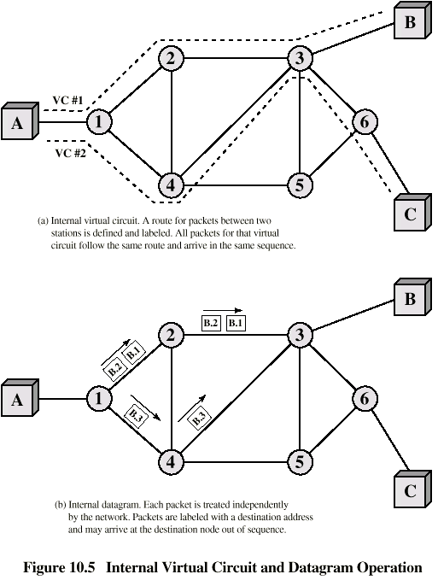
Internal
Virtual
Circuit and
Datagram
Operation
8.<number>

Slide 32

Figure 8.7 A datagram network with four switches (routers)
8.<number>

Slide 33

Figure 8.8 Routing table in a datagram network
8.<number>

Slide 34
Note
A switch in a datagram network uses a routing table that is based on the destination address.
8.<number>

Slide 35
Note
The destination address in the header of a packet in a datagram network
remains the same during the entire journey of the packet.
8.<number>

Slide 36

Figure 8.9 Delay in a datagram network
8.<number>

Slide 37
Note
Switching in the Internet is done by using the datagram approach
to packet switching at
the network layer.
8.<number>

Slide 38
8-3 VIRTUAL-CIRCUIT NETWORKS
A virtual-circuit network is a cross between a circuit-switched network and a datagram network. It has some characteristics of both.
Topics discussed in this section:
Addressing
Three Phases
Efficiency
Delay
Circuit-Switched Technology in WANs
8.<number>

Slide 39

Figure 8.10 Virtual-circuit network
8.<number>

Slide 40

Figure 8.11 Virtual-circuit identifier
8.<number>

Slide 41

Figure 8.12 Switch and tables in a virtual-circuit network
8.<number>

Slide 42

Figure 8.13 Source-to-destination data transfer in a virtual-circuit network
8.<number>

Slide 43

Figure 8.14 Setup request in a virtual-circuit network
8.<number>

Slide 44

Figure 8.15 Setup acknowledgment in a virtual-circuit network
8.<number>

Slide 45
Note
In virtual-circuit switching, all packets belonging to the same source and
destination travel the same path;
but the packets may arrive at the destination with different delays
if resource allocation is on demand.
8.<number>

Slide 46

Figure 8.16 Delay in a virtual-circuit network
8.<number>

Slide 47
Note
Switching at the data link layer in a switched WAN is normally
implemented by using
virtual-circuit techniques.
8.<number>

Slide 48
S(witched)VC vs. P(ermanent)VC setup
A virtual circuit can be either switched or permanent.
If permanent, an outgoing VCI is given to the source,
and an incoming VCI is given to the destination.
The source always uses this VCI to send frames to
this particular destination.
The destination knows that the frame is coming from
that particular source if the frame carries the
corresponding incoming VCI.
If a duplex connection is needed, two virtual circuits
are established.
8.<number>

Slide 49
S(witched)VC vs. P(ermanent)VC setup
A PVC has several drawbacks:
1. Always connected, so always paying
2. Connection is between two parties only. If
you need a connection to another point, you
need another PVC.
Don’t like these disadvantages? Use an SVC.
8.<number>

Slide 50
8-4 STRUCTURE OF A SWITCH
We use switches in circuit-switched and packet-switched networks. In this section, we discuss the structures of the switches used in each type of network.
Topics discussed in this section:
Structure of Circuit Switches
Structure of Packet Switches
8.<number>

Slide 51

Figure 8.17 Crossbar switch with three inputs and four outputs
8.<number>

Slide 52

Figure 8.18 Multistage switch
8.<number>

Slide 53
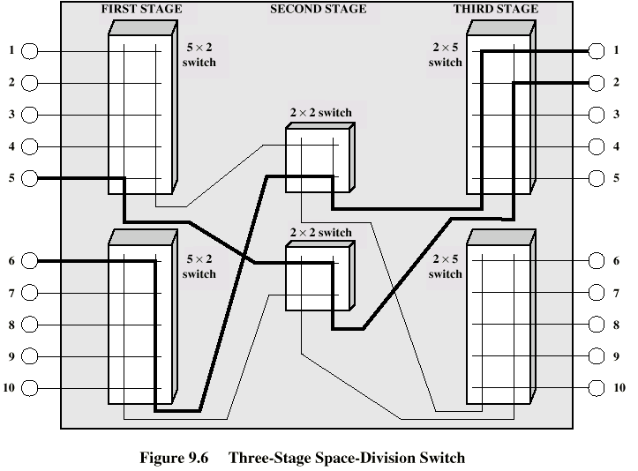
Three Stage Switch
8.<number>

Slide 54

Figure 8.19 Time-slot interchange
8.<number>

Slide 55

Figure 8.20 Time-space-time switch
8.<number>

Slide 56

Figure 8.21 Packet switch components
8.<number>

Slide 57

Figure 8.22 Input port
8.<number>

Slide 58

Figure 8.23 Output port
8.<number>

Slide 59

Figure 8.24 A banyan switch
8.<number>

Slide 60

Figure 8.25 Examples of routing in a banyan switch
8.<number>

Slide 61
In Summary
What are the differences between a circuit switched network and a packet switched network?
Where can the control signals travel in a telephone network?
What is a non-blocking switch/network?
What are the differences between datagram packet switched and virtual circuit packet switched?
8.<number>

Slide 62
In Summary
What are the differences between a circuit switch and a packet switch?
8.<number>

